Slide 1

FOBO KILLER

Slide 2


Ever spent hours looking for the perfect restaurant for dinner ?
ENDED UP COOKING PASTA ?
What if a computer could read ?
Notes:
Keep it short

Slide 3
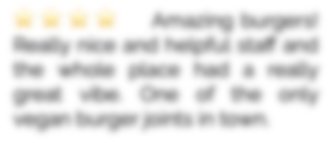

A solution : FOBO Killer
What if a computer could read ?
• Our goal : gain more insights on restaurant than a 5-stars grade
• Natural Language Processing
• Scrap the web to create our own dataset
Notes:
Keep it short

Slide 4
DEMO
Notes:
phrase basique au début
puis plus complexe
Focus sur l’UX, pas ce qu’il y a derrière, juste effet wahou
Si temps de chargement trop long on insère du théorique ?

Slide 5
How can a machine read ?
We can translate words into numbers !
Nice
Malfoy
Anakin
Dumbledore
Young
Old
Harry Potter
Voldemort
Evil
Notes:
Pour savoir quel valeur on associe à notre mot on entraine des modèles de deep-learning sur des corpus énormes
TODO :
Refaire le graphique

Slide 6
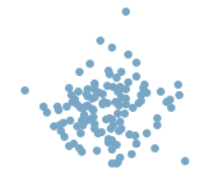
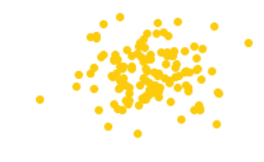
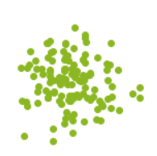
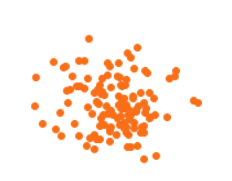
I’m not gonna eat numbers
But I can use them to measure distances !
I want to eat a burger without meat
Notes:
Numbers are cool : we can compute distance
• Home-made metrics

Slide 7


Could I know the drivers of a good rate ?
We trained a classification model…
CNN Model
Good (4 or 5 stars)
Bad (3 stars or below)
Amazing burgers! Really nice and helpful staff and the whole place had a really great vibe. One of the only vegan burger joints in town.

Slide 8
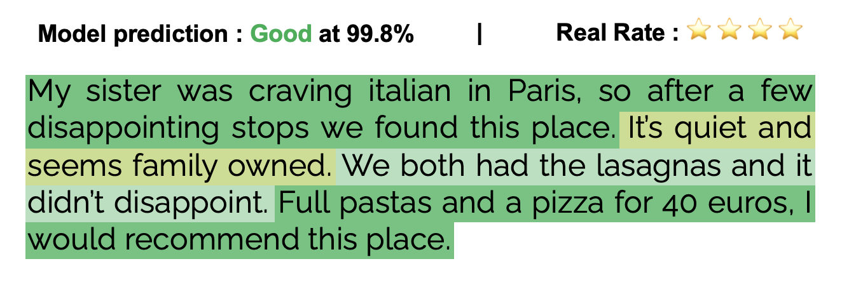
And it can be pretty fascinating…
Look at some results we’ve got

Slide 9

FOBO rules today's world
Bon appétit !

